Slide 1

Chapter 7:
2D Arrays
By Tony Gaddis
Slides modified and supplemented by Clare Nguyen

Slide 2
7.8
Two-Dimensional Arrays

Slide 3
Two-Dimensional Arrays
A 2D array is like a matrix or a table in a spreadsheet: it is made of a number of rows and columns
Requires 2 size declarations and 2 indexes: number of rows and number of columns
const int ROWS = 4, COLS = 3; int exams[ROWS][COLS];
First index is number of rows, second index is number of columns
Use two subscripts to access an element: exams[2][2] = 86;
columns
exams[0][0] | exams[0][1] | exams[0][2]
exams[1][0] | exams[1][1] | exams[1][2]
exams[2][0] | exams[2][1] | exams[2][2]
exams[3][0] | exams[3][1] | exams[3][2]
r
o
w
s
86

Slide 4
2D Array Initialization
2D arrays are initialized row-by-row: const int ROWS = 2, COLS = 2; int exams[ROWS][COLS] = { {84,78}, {92,97} };
Can omit inner {}
int exams[ROWS][COLS] = {84,78,92,97};
If the first elements in a row are initialized, the rest of the elements will be set to 0
84 | 78
92 | 97

Slide 5
2D Arrays and Functions
Function call: Use array name as an argument in the function call:
getExams(exams, 2);
Just like with 1D arrays, getExams gets passed the address of the exams array and it can modify the array
Pass the number of rows as a separate argument
Function prototype and function header:
For the array parameter, use empty [] for row but fill in the size of the column
Need a second parameter for the number of rows const int COLS = 2; // Prototype void getExams(int exams[][COLS], int rows); // Header void getExams(int exams[][COLS], int rows);

Slide 6
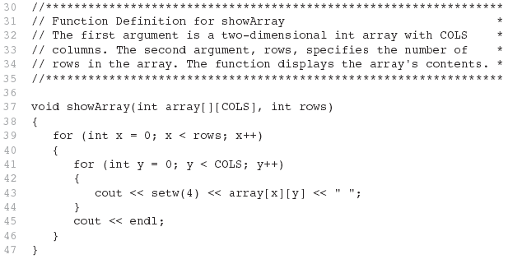
Example of 2D Array in the Called Function

Slide 7
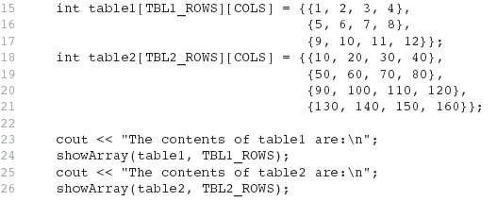
Example of 2D Array in Function Call

Slide 8
Example: Summing All Elements of a 2D Array
// Sum the array elements
for (int row = 0; row < NUM_ROWS; row++)
{
for (int col = 0; col < NUM_COLS; col++)
total += numbers[row][col];
}
// Display the sum.
cout << "The total is " << total << endl;

Slide 9
Example: Summing the Rows of a 2D Array
// Print each student's average score
for (int row = 0; row < NUM_STUDENTS; row++)
{
// Set the accumulator
total = 0;
// Sum 1 row
for (int col = 0; col < NUM_SCORES; col++)
total += scores[row][col];
// Calculate the average
average = total / NUM_SCORES;
// Print the average
cout << "Score average for student "
<< (row + 1) << " is " << average << endl;
}

Slide 10
Example: Summing the Columns of a 2D Array
// Print the class average for each score
for (int col = 0; col < NUM_SCORES; col++)
{
// Set the accumulator
total = 0;
// Sum 1 column
for (int row = 0; row < NUM_STUDENTS; row++)
total += scores[row][col];
// Get the average
average = total / NUM_STUDENTS;
// Print the class average
cout << "Class average for test " << (col + 1)
<< " is " << average << endl;
}

Slide 11
7.9
Arrays with Three or More Dimensions

Slide 12
Arrays with Three or More Dimensions
Can define arrays with any number of dimensions:
int rectSolid[2][3][5];
double timeGrid[3][4][3][4];
When used as parameter, specify all but 1st dimension in function prototype and function header:
// prototype
void getRectSolid(int [][3][5], int);
double getTimeGrid (int [][4][3][4], int);
// header
void getRectSolid(int rectSolid [][3][5],
int firstD);
double getTimeGrid (double timeGrid [][4][3][4],
int firstD);

Slide 13
Chapter 8:
Binary Search

Slide 14
8.2
Binary Search

Slide 15
Binary Search
Requires array elements to be in order first, so sorting the array may be needed before the binary search can run
Runs with a loop, starting with the full size of the array as the search area
With each pass of the loop, the search area is half the size of the previous search area:
Find the middle element
If the middle element == the target: found, search is done
If the middle element < the target, the new search area is in the half of the array where data are greater than the middle
If the middle element > target, the new search area is in the half of the array where data are less than the middle
If the new search area has at least 1 element, loop back to step1
Advantage of binary search compared to sequential search:
More efficient for large arrays because we cut the search area in half with each pass of the search loop
Disadvantages:
Requires the array elements to be sorted first

Slide 16
Binary Search Example
Array numlist contains:
Searching for the value 3:
Search area is from index 0 to 6, the middle value is at index 3
Compare the target 3 with the middle value 11
Since 3 < 11, new search area is from index 0 to 2 (first half), and the middle value is at index 1
Compare the target 3 with the middle value 3: found
Searching for the value 20:
Search area is from index 0 to 6, the middle value is at index 3
Compare the target 20 with the middle value 11
Since 20 > 11, new search area is from index 4 to 6, and the middle value is at index 5
Compare the target 20 with middle value 23
Since 20 < 23, search area is from index 4 to index 4, and the middle value is at index 4
Compare the target 20 with the middle value 19
Since 20 > 19, new search area is from index 4 to index 3, which is not possible: not found
2 | 3 | 5 | 11 | 19 | 23 | 29

Slide 17
Binary Search Function
int binarySearch(int array[], int size, int target) { int first = 0, // first index last = size - 1, // last index
mid, // middle index position = -1; // index of found target bool found = false; // not found yet while (!found && first <= last) { mid = (first + last) / 2; if (array[mid] == target) // match { found = true; position = mid; } else if (array[mid] > target) last = mid - 1; // search area = first half else // array[mid] < target first = mid + 1; // search area = last half } return position; }

Slide 18
Insertion Sort

Slide 19
Insertion Sort
Uses a loop to walk the array from beginning to end and examines each element.
With each element, insert it at the correct location in the array
Start at the second element as the current element
Compare the current element with each element in front of it
If the element in front is larger, move it over by 1 place to the right in the array
Stop comparing when the element in front is smaller or equal to the current element, or when reaching the begin of the array
When the comparison stops, move the current element to the location in the array where the comparison stops
4
7
25
5
45
2
14
18
10
comparing temp
current element
5
temp

Slide 20
Insertion Sort Function
void insertionSort (arr[], int size) { int current = 1, // start at index 1 last = size - 1, // last index
temp, // storage for current element walker; // index to walk and compare while (current <= last) { temp = arr[current]; // copy current element to temp walker = current – 1; // walker at element in front
while (walker >= 0 // walk until front of array
&& temp < arr[walker]) // or until current > front { arr[walker+1] = arr[walker]; // shift front to right
walker = walker – 1; // go to next front } arr[walker+1] = temp // insert current to the proper
// location in the array current = current + 1; // next element for current } }

